Slide 1
21ECPT0 – DEEP LEARNING FOR SPEECH PROCESSING
HEART LUNG SOUND SEPARATION FOR MEDICAL DIAGNOSIS
Gladson K

Slide 2
CONTENTS
Introduction
Literature Review
Research Gap
Algorithm
Heart Sound Signal Analysis
Lung Sound Signal Analysis
Probable Separation Area
References

Slide 3
INTRODUCTION
Auscultation is important in diagnosing heart and lung disease symptoms by analysing its sound waves through stethoscope.
The problem is that there is difficulty in separating heart and lung sounds as their time and frequency components overlap with each other .
Since the research for separating signals is going till now, there is not a customized product to separate heart and lung sounds till now.

Slide 4
LITERATURE REVIEW
JOURNAL DETAILS | Hybrid Nelder-Mead search based optimal Least Mean Square algorithms for heart and lung sound separation Ruban Nersisson , Mathew M. Noel School of Electrical Engineering, VIT University, Vellore, India
OBJECTIVE | An improved adaptive noise cancellation technique based on the Least Mean Square (LMS) algorithm is used to separate heart sounds from lung sounds. The step size parameter in the LMS algorithm is optimally chosen using a hybrid Nelder-Mead (H-NM) optimization algorithm.
METHODOLOGY USED | Hybrid Nelder – Mead Optimization, LMS , Noise Cancellation, Particle Swarm Optimisation
DATASET/INPUT DETAILS | Heart and lung sound data
HARDWARE/SOFTWARE DETAILS USED IN JOURNAL | MATLAB/Python
ANY COMPARISONS WITH EXISTING METHODS, | Correlation coefficient is higher for heart sound signal from input signal.

Slide 5
LITERATURE REVIEW
JOURNAL DETAILS | Noisy Neonatal Chest Sound Separation for High-Quality Heart and Lung Sounds E. GROOBY, Student Member, IEEE, C. SITAULA, D. FATTAHI, R. SAMENI, Senior Member, IEEE, K. TAN, L. ZHOU, A. KING, A. RAMANATHAN, A. MALHOTRA, G.A. DUMONT, Life Fellow, IEEE, AND F. MARZBANRAD, Senior Member, IEEE
OBJECTIVE | This paper presents novel Non-negative Matrix Factorisation (NMF) and Non-negative Matrix Co-Factorisation (NMCF) methods for neonatal chest sound separation.
METHODOLOGY USED | Autoencoder, Adaptive Fourier Decomposition, Non-negative matrix Factorisation and Cofactorisation , Wavelet Transform
DATASET/INPUT DETAILS | Noisy Neonatal Heart and lung sound data
HARDWARE/SOFTWARE DETAILS USED IN JOURNAL | MATLAB
ANY COMPARISONS WITH EXISTING METHODS, | NMF performed with SNR 2.6 dB and NMCF performed with SNR 11.6 dB

Slide 6
LITERATURE REVIEW
JOURNAL DETAILS | Heart sound and lung sound separation algorithms: a review Ruban Nersisson , Mathew M. Noel School of Electrical Engineering, VIT University, Vellore, India
OBJECTIVE | A study is carried out on different algorithms used for the separation of HSS from LSS, and also the results of major four separation algorithms are compared.
METHODOLOGY USED | Adaptive Line Enhancement, Spectrogram Independent Component Analysis, Adaptive filter with Automatic gain Control
DATASET/INPUT DETAILS | Heart and lung sound data
HARDWARE/SOFTWARE DETAILS USED IN JOURNAL | MATLAB
ANY COMPARISONS WITH EXISTING METHODS, | A comparative study between 4 algorithms is received.

Slide 7
LITERATURE REVIEW
JOURNAL DETAILS | Hemodynamics-driven mathematical model of first and second heart sound generation Mehrdad ShahmohammadiID1 *, Hongxing Luo2 , Philip Westphal2,3, Richard N. Cornelussen2,3, Frits W. Prinzen2 , Tammo DelhaasID
OBJECTIVE | our hemodynamics-driven mathematical model provides fast and realistic simulations of heart sounds under various conditions and may be helpful to find new indicators for diagnosis and prognosis of cardiac diseases.
METHODOLOGY USED | Mathematical modelling for CircAdapt, a lumped-parameter real-time computational model of the cardiovascular system chirp signal modelling
DATASET/INPUT DETAILS | No Input Data modelling
HARDWARE/SOFTWARE DETAILS USED IN JOURNAL | MATLAB
ANY COMPARISONS WITH EXISTING METHODS, | It can be used in separating heart signal from given signal

Slide 8
LITERATURE REVIEW
JOURNAL DETAILS | System of heart and lung sounds separation for store-and-forward telemedicine applications Antonio JosÈ Salazar*1, Catalina Alvarado1 , Fernando Enrique Lozano2 1 Biomedical Engineering Group (GIB). University of Los Andes. EdiÆ cio Mario Laserna Cra 1 Este No . 19A-40. Bogot·, Colombia.
OBJECTIVE | we apply modulation filters to the time-frequency representation of the original signal, recorded on the chest. Second, we apply an iterative algorithm of wavelet decomposition and reconstruction filters
METHODOLOGY USED | Short Time Fourier Transform, Adaptive bandpass filter, Inverse Short time Fourier Tranform
DATASET/INPUT DETAILS | Heart and lung sound recorded
HARDWARE/SOFTWARE DETAILS USED IN JOURNAL | Python/MATLAB
ANY COMPARISONS WITH EXISTING METHODS, | It is one of the hardware implemented procedure to filter heart signal from lung signal with effective rate of 10.21dB and 6.61dB

Slide 9
LITERATURE REVIEW
JOURNAL DETAILS | Reverberant blind separation of heart and lung sounds using nonnegative matrix factorization and auxiliary function technique Author links open overlay panel Yuan Xie, Kan Xie , Qiyu Yang, Shengli Xie
OBJECTIVE | A novel blind source separation (BSS) method is proposed based on nonnegative matrix factorization (NMF) and auxiliary function technique for the separation of heart sound mixtures and lung sound mixtures in the reverberation environment
METHODOLOGY USED | DSS denoising, Non-negative matrix factorization and auxiliary function
DATASET/INPUT DETAILS | Heart and lung sound recorded
HARDWARE/SOFTWARE DETAILS USED IN JOURNAL | Stethoscope, STFT filter, MATLAB
ANY COMPARISONS WITH EXISTING METHODS, | This paper also uses Non-negative matrix factorization technique

Slide 10
LITERATURE REVIEW
JOURNAL DETAILS | Blind Monaural Source Separation on Heart and Lung Sounds Based on Periodic-Coded Deep Autoencoder Kun-Hsi Tsai1, Wei-Chien Wang1, Chui-Hsuan Cheng1, Chan-Yen Tsai1, Jou-Kou Wang2, Tzu-Hao Lin3, Shih-Hau Fang4, Li-Chin Chen5, Yu Tsao5
OBJECTIVE | A novel periodicity-coded deep auto-encoder (PC-DAE) approach to separate mixed heart-lung sounds in an unsupervised manner via the assumption of different periodicities between heart rate and respiration rate.
METHODOLOGY USED | Supervised Non negative matrix factorization and deep autoencoder
DATASET/INPUT DETAILS | Heart and lung sound recorded
HARDWARE/SOFTWARE DETAILS USED IN JOURNAL | Python
ANY COMPARISONS WITH EXISTING METHODS, | PC-DAE does not require supervised training data to train

Slide 11
LITERATURE REVIEW
JOURNAL DETAILS | A wavelet-based reduction of heart sound noise from lung sound Leontios J. Hadjileontiadis, Stavros M. Panas
OBJECTIVE | The use of a wavelet transform domain filtering technique as an adaptive de-noising tool, implemented in lung sounds analysis, is presented. The multiresolution representations of the signal, produced by wavelet transform, are used for signal structure extraction.
METHODOLOGY USED | Adaptive denoising, Wavelet Transform
DATASET/INPUT DETAILS | Heart and lung sound recorded
HARDWARE/SOFTWARE DETAILS USED IN JOURNAL | Python
ANY COMPARISONS WITH EXISTING METHODS, | Many methodologies uses wavelet based reduction

Slide 12
LITERATURE REVIEW
JOURNAL DETAILS | Mathematical modelling of lung function — what have we learnt and where to next? AK Rampadarath ¹, GM Donovan
OBJECTIVE | Potential development of patient-specific diagnosis and treatment of respiratory illnesses. For example, the AIRPROM project developed patient-specific, multiscale computational models specifically for asthma and COPD
METHODOLOGY USED | AIRPROM based mathematical modeling
DATASET/INPUT DETAILS | Heart and lung sound recorded
HARDWARE/SOFTWARE DETAILS USED IN JOURNAL | MATLAB
ANY COMPARISONS WITH EXISTING METHODS, | Mathematical Modelling of Heart Sound Signal

Slide 13
LITERATURE REVIEW
JOURNAL DETAILS | Cardiovascular Disease Recognition Based on Heartbeat Segmentation and Selection Process Mehrez Boulares, Reem Alotaibi, Amal AlMansour,and Ahmed Barnawi Published in Int J Environ Res Public Health. 2021 Oct; 18(20): 10952.
OBJECTIVE | IIR filter for automatic noise deletion; an automatic powerful Heart Cycle Segmentation (HCS) method based on envelop detection using Daubechies wavelet decomposition; a new HCS segment selection approach based on PCG feature clustering relaying on Gaussian mixture model (GMM), and an extensive experimental study based on 17 CNN pretrained and fine-tuned models for the automatic PCG disease classification.
METHODOLOGY USED | MFCC and Convolutional Neural Network
DATASET/INPUT DETAILS | Heart and lung sound recorded
HARDWARE/SOFTWARE DETAILS USED IN JOURNAL | Python
ANY COMPARISONS WITH EXISTING METHODS, | Autoencoder based deep learning approach is similar to this approach

Slide 14
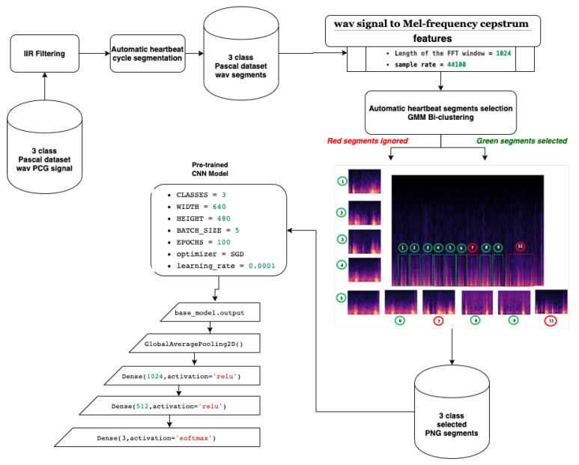
ALGORITHM

Slide 15
RESEARCH GAP
Still there is not a proper hardware tool to separate heart sound signal from lung sound signal.
The efficiency is still questionable as their time and frequency components overlap with each other along with noise factors such as AWGN, Air noise present down stomach and excessive expiration and inspiration

Slide 16
HEART SOUND SIGNAL ANALYSIS
S1 Sound – Closing of Mitral and Tricuspid Valve in Systole (20-60Hz)
S2 Sound – Closing of Aortic and Pulmonic Valve in Diastole(80 – 200Hz)
S3 Sound – Diastolic Murmurs (AR, PR, TS, MS) (<40Hz)
S4 Sound – Diastolic Murmurs(20-40 Hz)
S5 Sound – Extra Sounds

Slide 17
LUNG SOUND SIGNAL ANALYSIS
Vesicular Sound – (<800 Hz and peak at 150 Hz)
Bronchial Sound – (150 -3000 Hz and Peak at 500 Hz)
Crackles Sound Fine – (400 – 2000 Hz)
Crackles Sound Coarse – (100 – 600 Hz)
Wheezes Sound – (100 – 1000 Hz and Peak at 400 Hz)

Slide 18
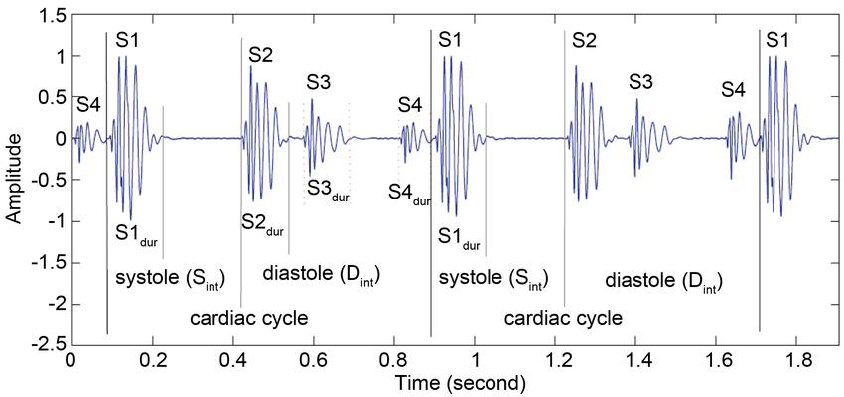
PROBABLE SEPARATION AREA
Heart Sound Signal – (20 – 200 Hz)
  20 – 40 dB for S1, S2
  10 – 30 dB for S3, S4

Slide 19
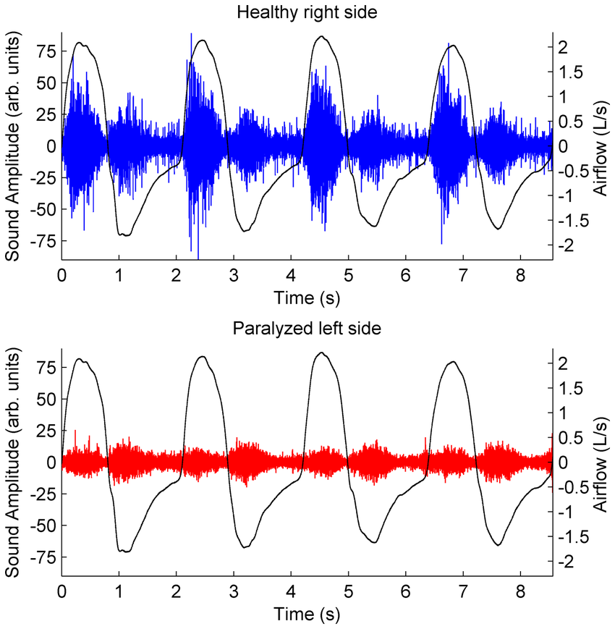
PROBABLE SEPARATION AREA
Lung Sound Signal – (<4200 Hz)
  Vesicular 20 to 30 dB
  Bronchial 30 to 60 dB
  Crackles 40 to 70 dB
  Wheezes 50 to 90 dB

Slide 20
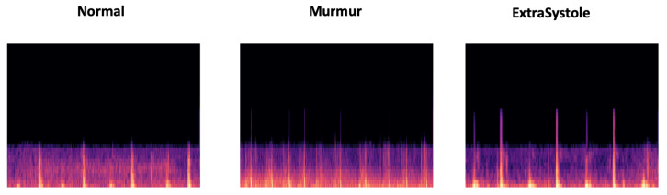
PROBABLE SEPARATION AREA
MFCC Based separation images for Normal, Murmur, Extra Systole

Slide 21
ALGORITHM
Preprocess the signal by using
Kaiser Window BPF – HSS
Kaiser Window HPF – LSS
2. Use Daubechius Wavelet Filter
BPF – HSS
HPF – LSS
Use Recursive Least Square Algorithm
for the output of wavelet filter of HSS and LSS
4. Conversion to MFCC Image

Slide 22
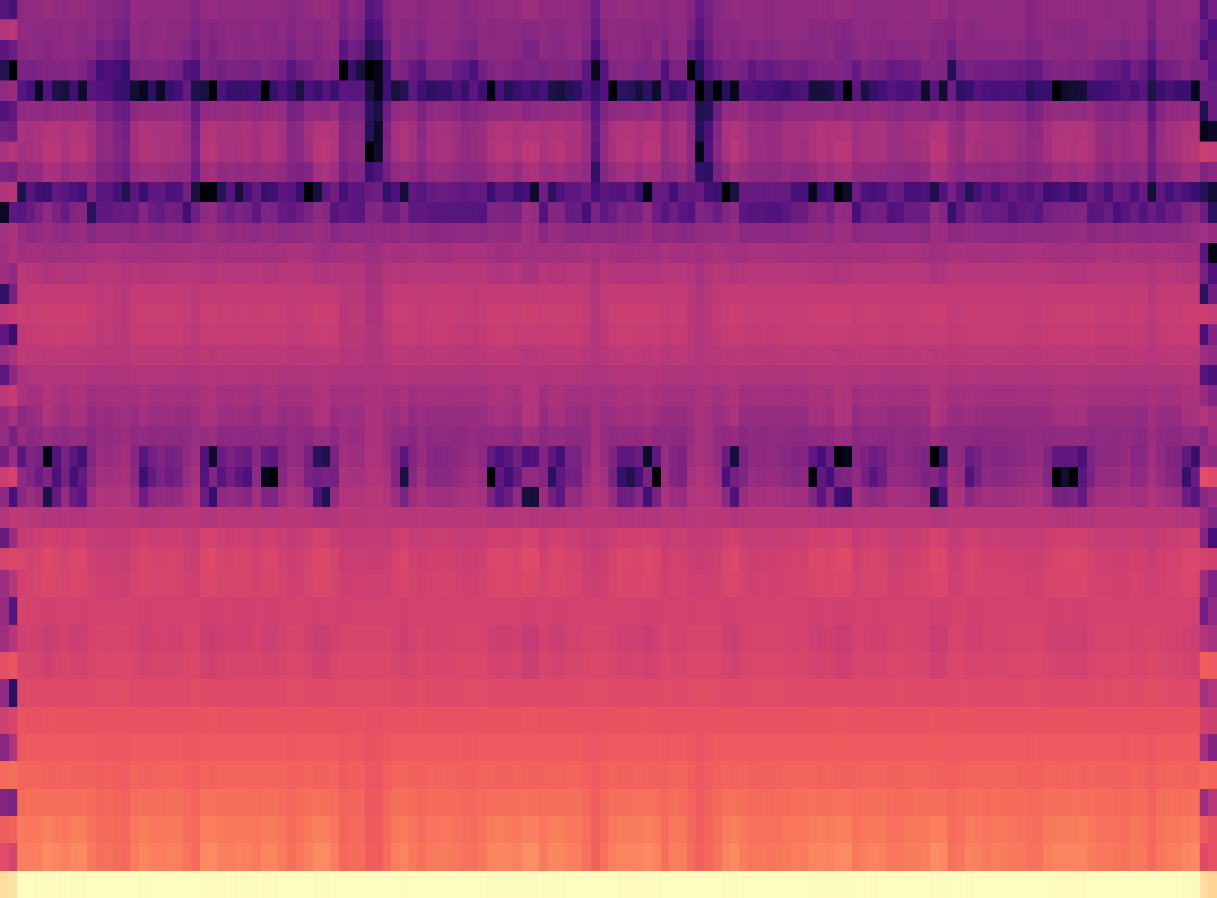
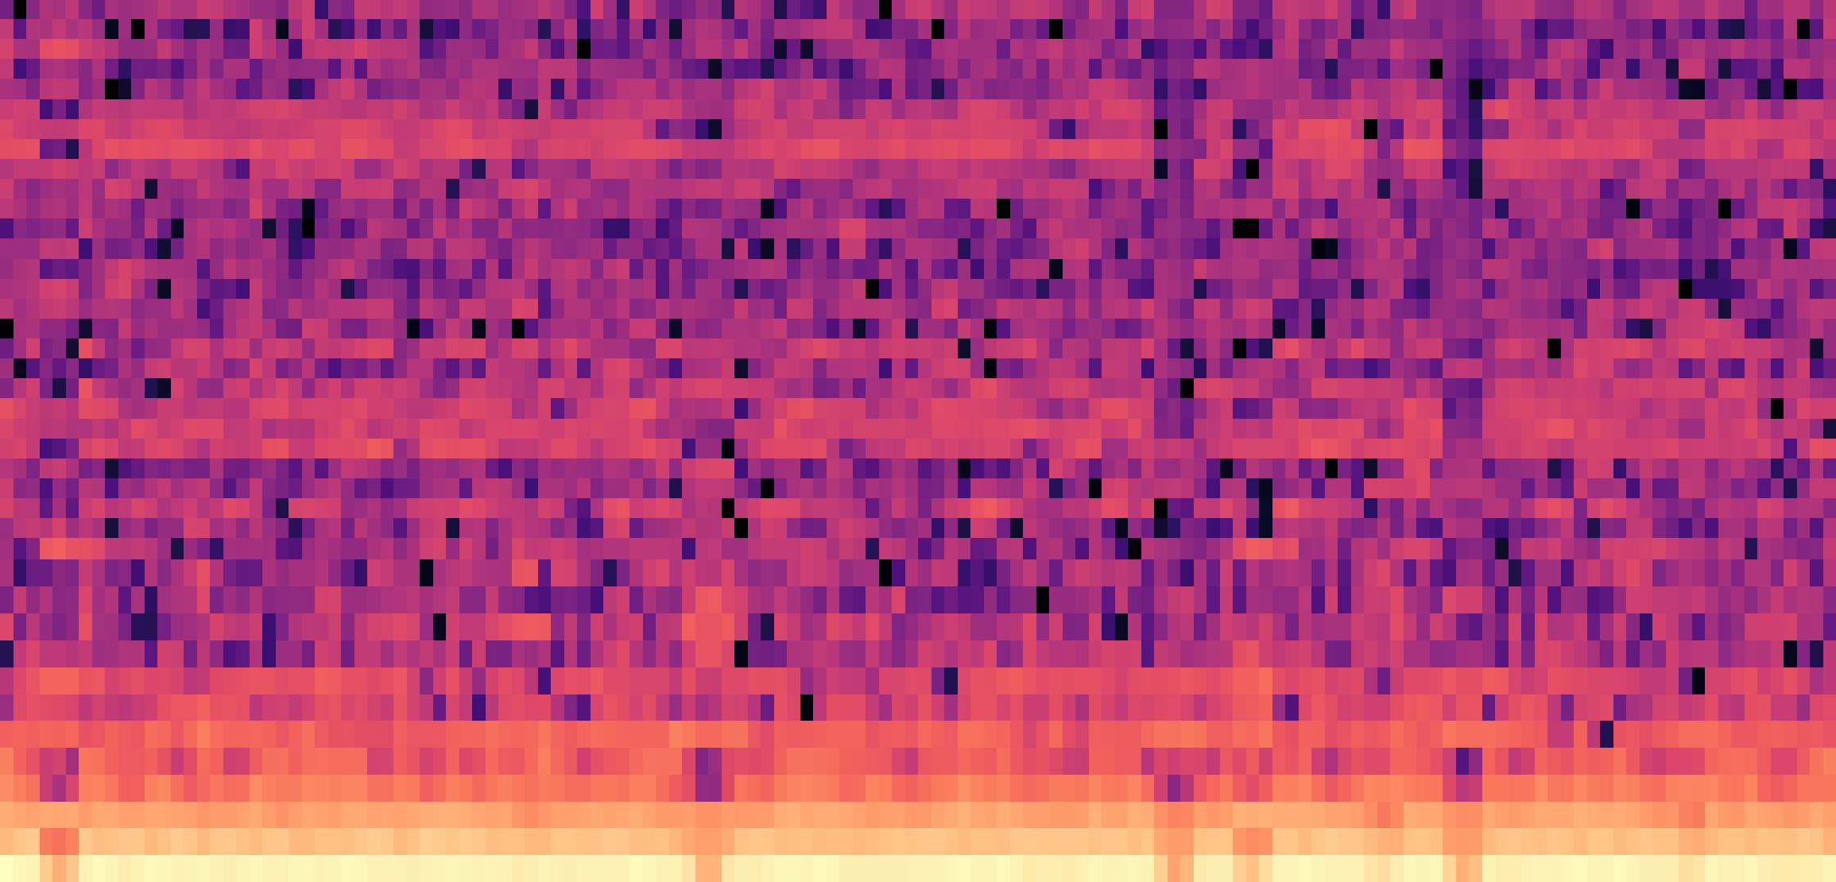
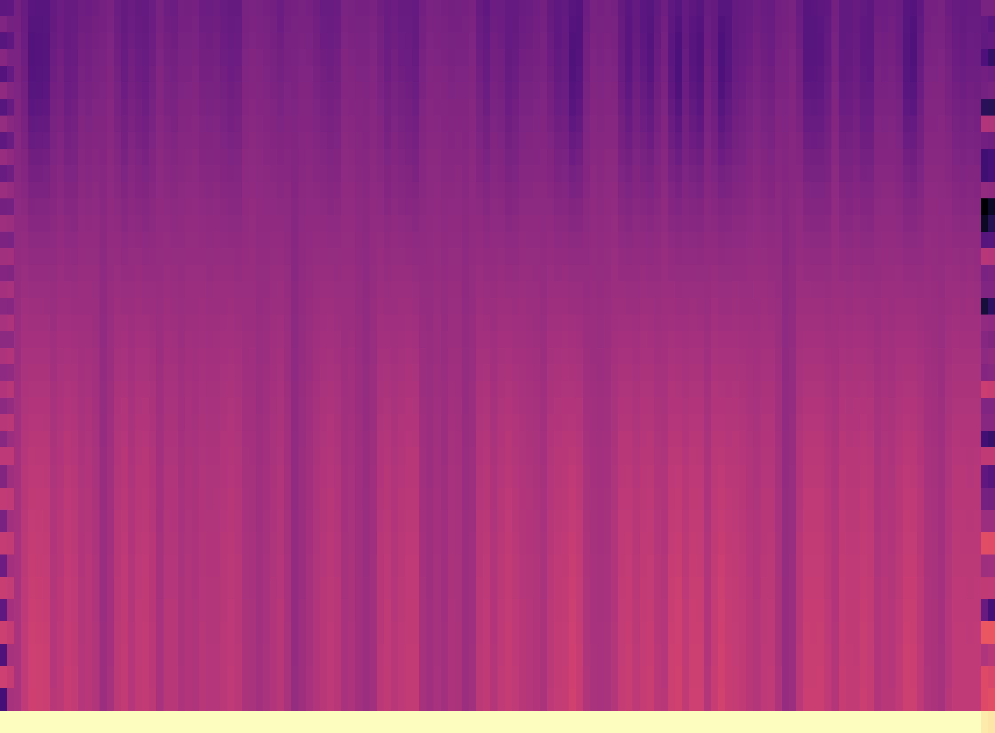
WORK DONE
HSS after Processing
LSS after Processing
Input Audio MFCC before Processing

Slide 23
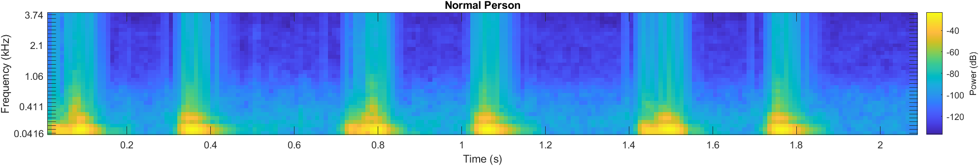
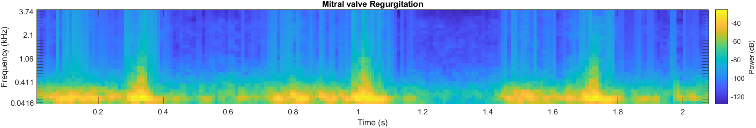
DISEASE DETECTION
Normal Person Heart sound MFCC
Mitral Valve Regurgitation

Slide 24
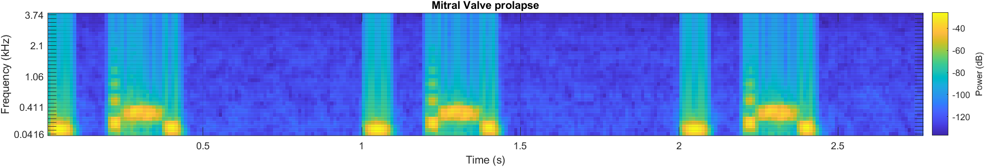
DISEASE DETECTION
Mitral Valve Prolapse

Slide 25
ALGORITHM – TO BE DONE
We have to perform periodic clustering by analysing S1 S2 heart sound in interval of 0 to 20 milliseconds for processing the image from left to right and segment its parts by relating it out with violet based pixel arousing in horizontal line as limit for its variation.
Next We can process the MFCC image of HSS and LSS using GRU based Deep Neural Network for processing MFCC image and find the labels out for HSS and LSS
After GRU based neural network we opt to process the neural network output with optimization algorithm and check for possibility of construction of R-CNN based network for segmenting and classifying each sound in heart as well as lungs and segment as output and predict probability of disease occurrence

Slide 26
ALGORITHM – TO BE DONE
Google Colab Link : Heart data preprocessing - Colaboratory (google.com)
MFCC Image Link: Data Sets - Google Drive

Slide 27
REFERENCES
Modeling and Simulation of Pulmonary Acoustic Signal and Imaging for Lung Function Assessment | IEEE Conference Publication | IEEE Xplore
Mathematical modelling of lung function — what have we learnt and where to next? - ScienceDirect
Cardiovascular Disease Recognition Based on Heartbeat Segmentation and Selection Process - PMC (nih.gov)
https://drive.google.com/drive/folders/1PzWx71w-v6jf9BtW7zJgf52HJ69nT13C?usp=sharing
.

Slide 28
THANK YOU

